Slide 1
Defensible Quality Control for E-Discovery
Geoff Black and Albert Barsocchini

Slide 2
Question for the Audience
How do you defend
your collections?

Slide 3
Full Disk Image – safe, but costly and time consuming
User-Created Data – probably the most often used in discovery
Targeted Collections Based on Early Case Assessment – the current trend

Slide 4
Full Disk Image | User-Created Data | Targeted
Let the downstream tools (processing, filtering, review) do the work.
Sampling is still beneficial for all of these collection methods.

Slide 5
More discovery about discovery
More sanction decisions
Utilizing more than one methodology or technology at different stages of the process
Transparency in the discovery process
Courts expect attorneys to understand available technology and use it

Slide 6
The increased use of lawyers with practices focused on eDiscovery
Attorneys must demonstrate that the discovery process used is defensible and reasonable
Increased adoption of predictive coding
Courts expect discovery to be proportional to the case
Still no single "magic bullet" to solve the challenges of discovery

Slide 7
Increased adoption of information governance programs, including defensible disposal of data.
Proliferation of data sources
The days of granting carte blanche discovery are over
More use of early case assessment

Slide 8
Sampling – Why Do It?
Ensure Quality and accuracy of the collection or of the processing results
Defensibility

Slide 9
Types of Sampling
Judgmental – subjectively defined data set
Statistical – randomly selected data

Slide 10
The Challenges
Select appropriate filters for the target data set
Accomplishing a high confidence level and low margin of error

Slide 11
Statistics – Margin of Error
Also known as the “confidence interval”
How closely results will reflect the general population
Lower margin of error is obviously better

Slide 12
Statistics – Margin of Error
We have 100 documents and our margin of error is ± 2%
Testing shows 10% responsiveness
So… the general population should show between 8% and 12% responsiveness, or 8 to 12 documents.

Slide 13
Statistics – Confidence Level
Does the sample accurately represent the results of general population?
Higher confidence level is better

Slide 14
Statistics – Confidence Level
What does a 95% Confidence Level mean?
95 out of 100 times, the population will match our sample’s results
Gallup Polls: 98% accuracy in Presidential elections

Slide 15
Statistics – Confidence Level
95%
-1.96
0
1.96

Slide 16
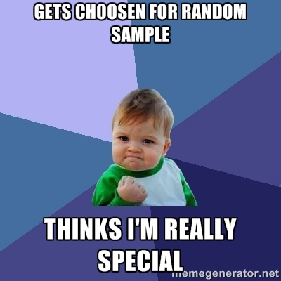
What’s The Catch?

Slide 17
What’s The Catch?
You must filter out documents that you know
for sure contain nothing of value:
.exe, .dll, etc.

Slide 18
Statistics for eDiscovery
Sample Sizes for Population of 1,000,000
Margin of Error

Slide 19
[Scaling] Statistics for eDiscovery
Population Size

Slide 20
[Scaling] Statistics for eDiscovery
“Every cook knows that it only takes a single sip from
a well-stirred soup to determine the taste.”
You can visualize what happens
when the soup is poorly stirred.
If well-stirred, a single sip is sufficient
both for a small pot and a large pot.

Slide 21
Sampling Workflow
Finding a good search method is difficult
Who chooses search terms?
Requires iterative testing and validation

Slide 22
Sampling Workflow
Select Random Sample
Review Sample for Relevance
Search sample with proposed keywords
Can be done in parallel
Compare results
Extrapolate expected relevance and error rates on data set

Slide 23
Sampling Workflow
Select Random Sample
Review Sample for Relevance
Search sample with proposed keywords
Can be done in parallel
Compare results
Iterate keywords, and re-test as necessary
Extrapolate expected relevance and error rates on data set

Slide 24
Sampling Workflow
Wait a minute, I always test my keywords!
Remember: It’s not whether you test, but what you test on…

Slide 25
Sampling Benefits
Small dataset for testing
Minimize false positives
More accurate search, reduced data volume
Defensibility of statistically validated testing

Slide 26
Pros
Cons
Saves the cost of loading into review platform
All steps performed in EnCase for collection, processing, and review
Requires an external EnScript for sampling
Extra step to import random sample results back into ECC
Review capabilities less than ideal

Slide 27
EnCase eDiscovery Workflow Hands-On
eDocs L01s
(Entries)
Collect Data in ECC
Fork to eDocs and Email L01s
Email L01s
(Records)
Sample eDocs L01s
Random Sampler EnScript
Review & Test
Sample Email L01s

Slide 28
EnCase eDiscovery Workflow Hands-On
eDocs L01s
(Entries)
Collect Data in ECC
Fork to eDocs and Email L01s
Email L01s
(Records)
Sample eDocs L01s
Random Sampler EnScript
Review & Test
Sample Email L01s

Slide 29
EnCase eDiscovery Workflow Hands-On
eDocs L01s
(Entries)
Collect Data in ECC
Fork to eDocs and Email L01s
Email L01s
(Records)
Sample eDocs L01s
Random Sampler EnScript
Review & Test
Sample Email L01s

Slide 30
EnCase eDiscovery Workflow Hands-On
eDocs L01s
(Entries)
Collect Data in ECC
Fork to eDocs and Email L01s
Email L01s
(Records)
Sample eDocs L01s
Random Sampler EnScript
Review & Test
Sample Email L01s

Slide 31
What is a “Workflow” in
EnCase eDiscovery?

Slide 32
EnCase eDiscovery Workflow Hands-On
eDocs L01s
(Entries)
Collect Data in ECC
Fork to eDocs and Email L01s
Email L01s
(Records)
Sample eDocs L01s
Random Sampler EnScript
Review & Test
Sample Email L01s

Slide 33
WF Collected eDocs
Look good?
Fork email from eDocs
WF Forked Email
WF Forked eDocs
Process Email
Process eDocs
WF Processed Email
WF Processed eDocs

Slide 34
WF Collected eDocs
Survey says…
Fork email from eDocs
WF Forked Email
WF Forked eDocs
Process Email
Process eDocs
WF Processed Email
WF Processed eDocs

Slide 35
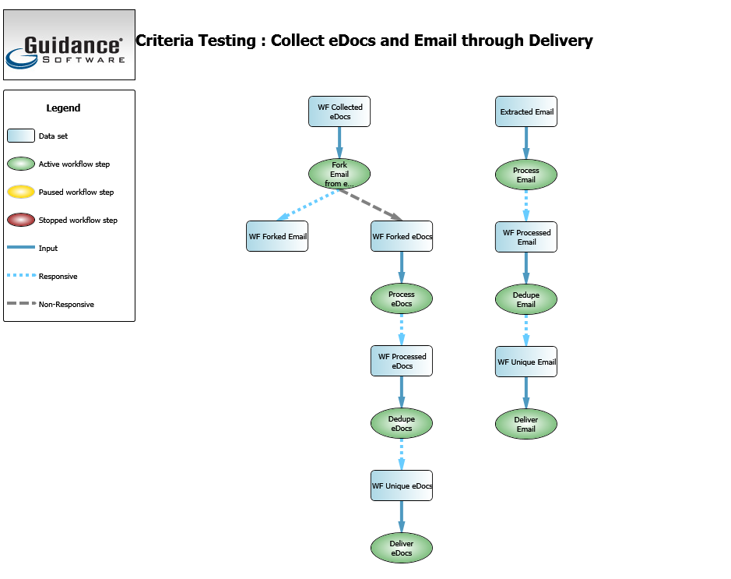

Slide 36
Magic

Slide 38
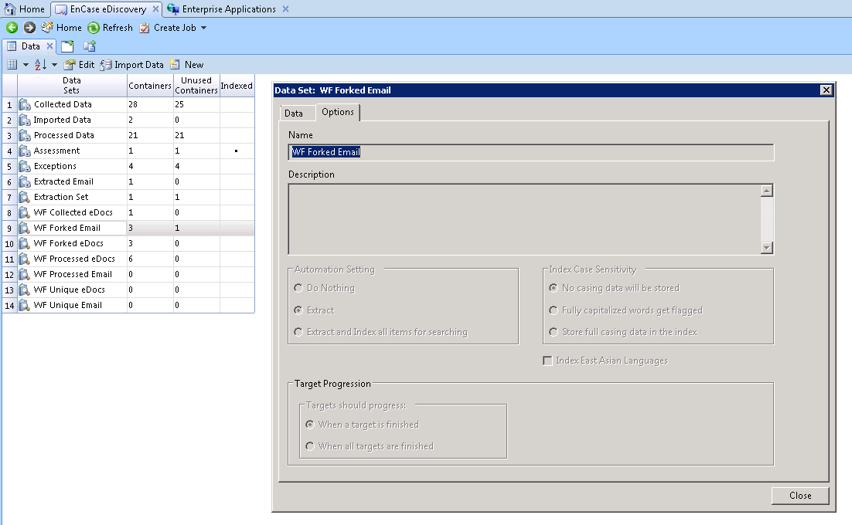

Slide 39
Random Sampler EnScript Hands-On
External EnScript, not a part of EnCase eDiscovery
Uses known formulas to determine sample size
Preferred input is L01's created by EnCase eDiscovery
Auto-detects the L01 type - Entries vs Records/Email
Creates a random sample across all of the L01's and outputs items to new sample L01's (“*.SAMPLES.L01”)
Notes:
Yes, it does work in v7…

Slide 40
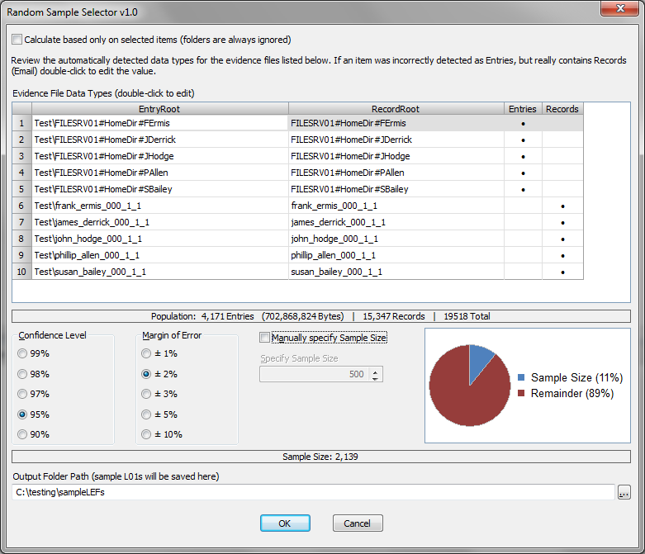
Random Sampler EnScript Hands-On
Notes:
Drag entries (docs) and records (email) L01’s into a new case. Run the EnScript. Check the auto-detected L01 types, and adjust if necessary. Select Confidence Level and Margin of Error; review the Sample Size. Choose an output folder and hit OK. Yes, it does work in v7…

Slide 41
Pros
Cons
Sampling can be performed directly in the review platform
Robust reviewer and oversight capabilities
Once the data is in the review platform, you don’t need to go back to EnCase
Extra costs associated
Split workflow requires moving data outside of EnCase and into review platform

Slide 42
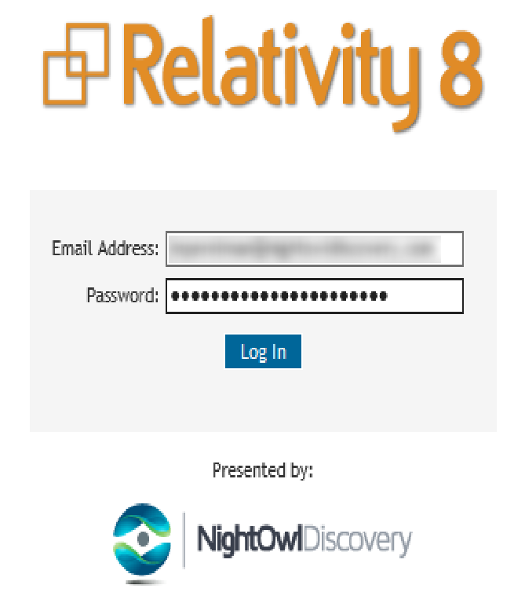
Statistical Sampling With Relativity
Notes:
Relativity 8 logon screen

Slide 43
Statistical Sampling With Relativity
Notes:
Choose the workspace (this is where your matter documents will be stored)

Slide 44
Statistical Sampling With Relativity
Notes:
Once in the matter, if not there by default, choose the “Documents” tab.
You can sample from the top level (“Salt vs Pepper”) on the upper left, or from any of the sub-folders, such as Custodians, Privilege, etc. This allows you to quickly sample a custodian for relevance, for example.
In our case, we have 76,468 reviewable items.
Our next step is to take a statistical random sample. We do this by clicking on the multicolored rectangle to the right of the “Search” (upper right). This toggles statistical sampling options on and off. It is important to note that the statistical sampling option is permission-based, so if you don’t see it in your instance it is likely that your administrator has to grant you explicit rights to do sampling.

Slide 45
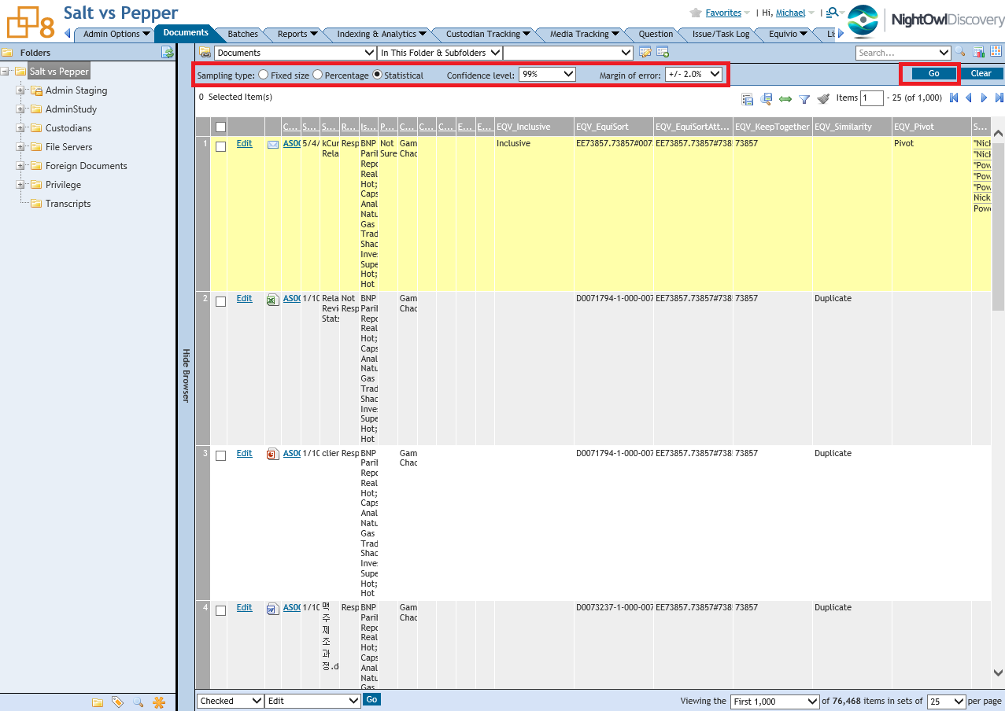
Statistical Sampling With Relativity
Notes:
There are three sampling types that are available: Fixed Size (you choose the number of items to sample), Percentage (specify the percentage of total documents in the matter or sub-folder or search), and Statistical. This is what we’ll focus on today.
In our example, we chose a 99% confidence level and a 2% margin of error. Once options are selected, click “Go” to get the result.

Slide 46
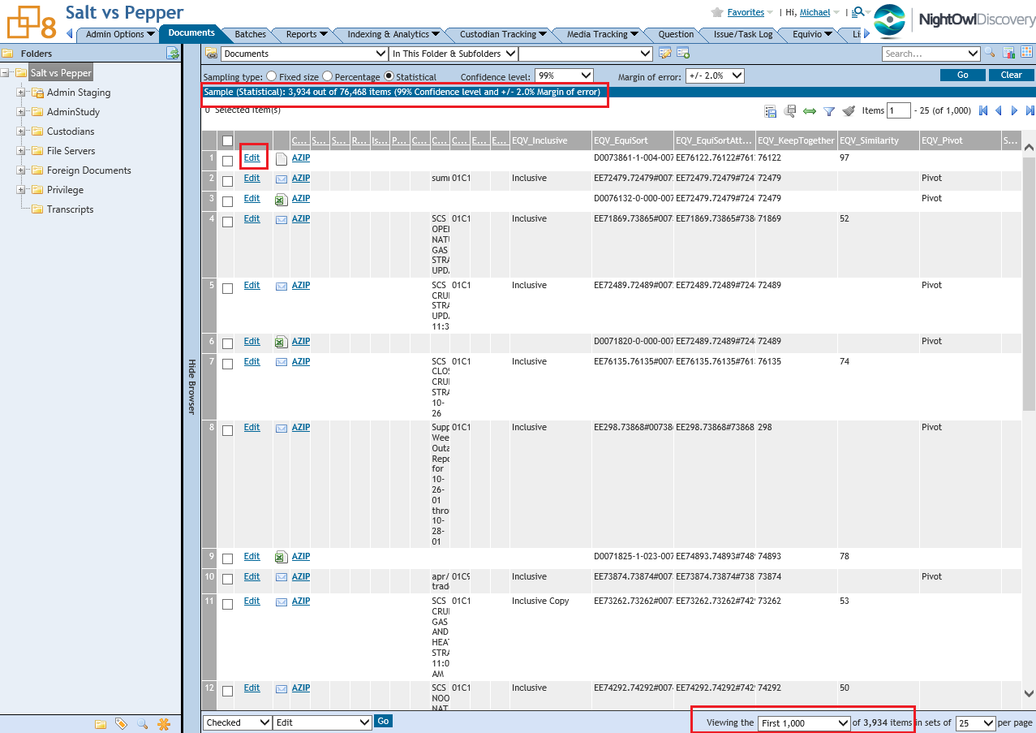
Statistical Sampling With Relativity
Notes:
Once the results are returned, you can see the sample size in two places: Just below the sampling options, and also on the bottom where you get to choose how many documents are loaded and viewed on a page at any given time. In our case, 3,934 items were returned.
At this point we have many options, including moving these items into a separate folder, creating a list, bulk-tagging, or simply reviewing the content.
In order to review, we click on the “Edit” button, or on the item name.

Slide 47
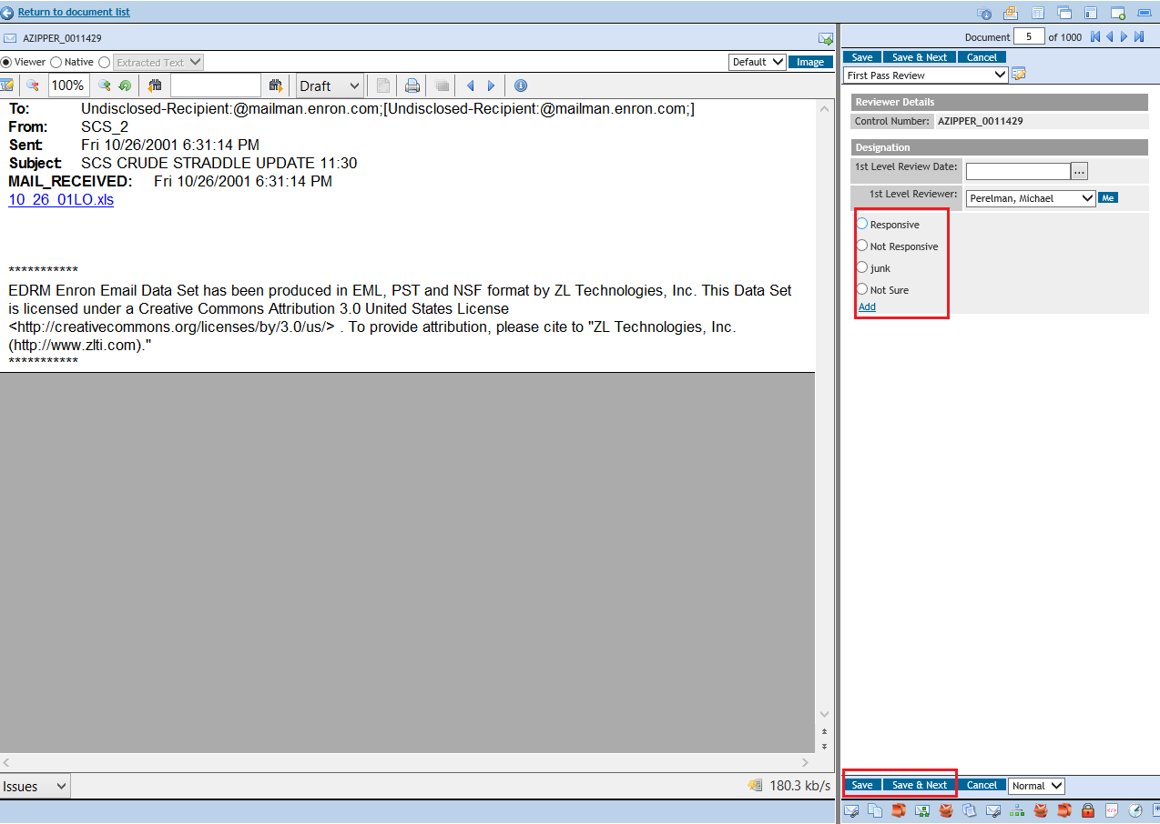
Statistical Sampling With Relativity
Notes:
Next, we bring up the review pane, where we can choose the responsiveness of the document, privilege, or any other issue you choose. This can be done to quickly check your reviewers’ work or as a way to do early assessment of your data before review began.

Slide 48
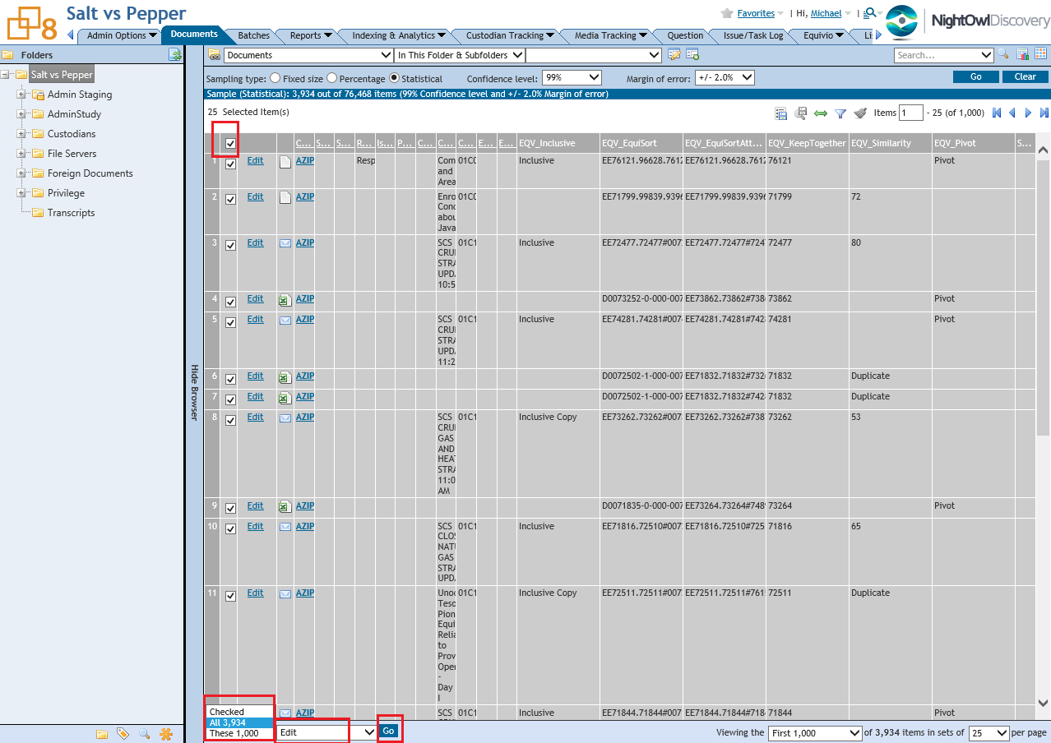
Statistical Sampling With Relativity
Notes:
This screen shows how to bulk-tag (or, in Relativity terms, Bulk-edit) a set of sampled documents. We can choose only the checked (at the top right), the first 1,000 loaded, or the entire set of 3,934.
In our case, we chose 3,934, chose “Edit”, and clicked “Go”

Slide 49
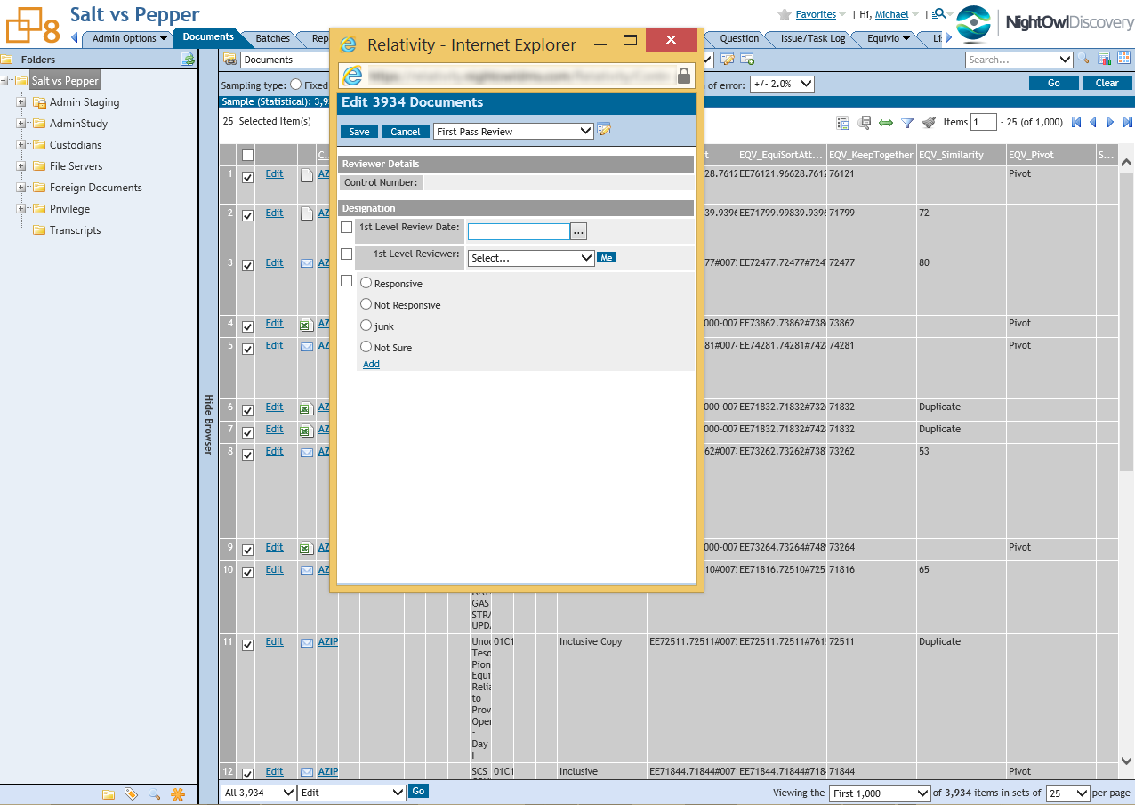
Statistical Sampling With Relativity
Notes:
A bulk edit popup appears, where we can tag all documents selected.

Slide 50
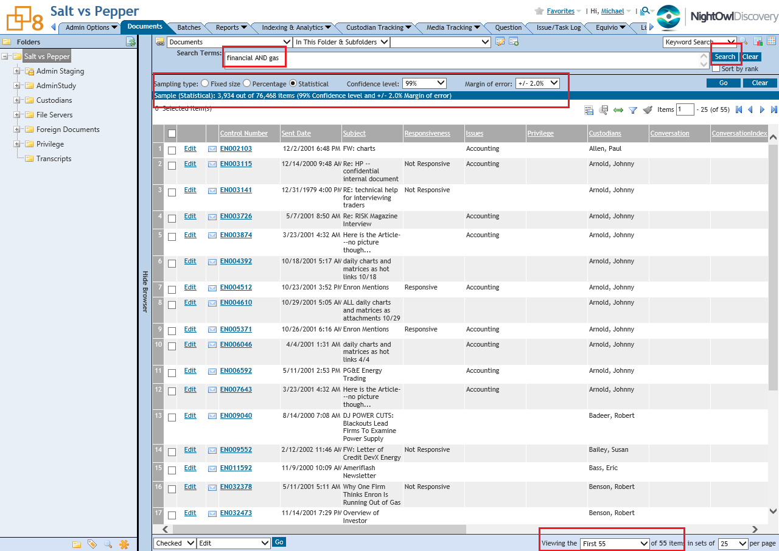
Statistical Sampling With Relativity
Notes:
Another option is to test a set of keywords against our statistical sample. To do that, we first get a sample as described before. We then apply keywords using either the native Relativity keyword search or using dtSearch functionality.
In our case, running the keywords “financial AND gas” resulted in 55 items out of 3,934 sampled. These results can be compared against reviewer tags for the sample set. This process allows for defensible, statistically sound, keyword testing with document samples.

Slide 51
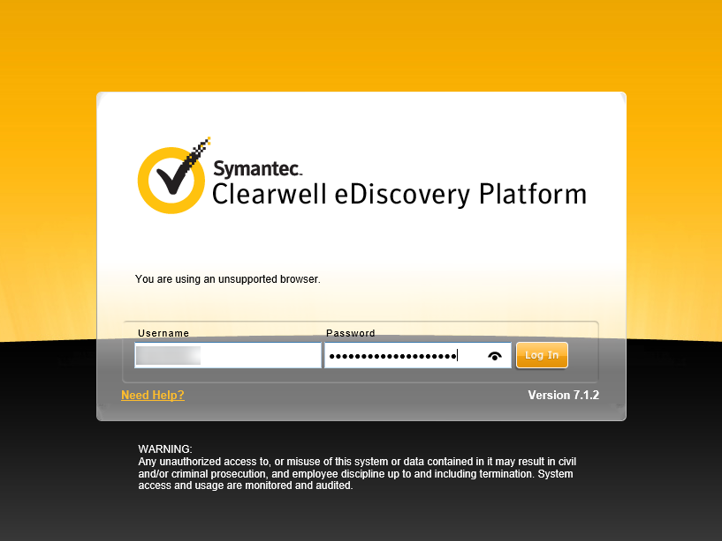
Statistical Sampling With Clearwell
Notes:
With Clearwell, we can also choose a fixed size, a percentage or have the system calculate a sample size for us based on our desired confidence level and margin of error. . One can use an online statistical calculator to determine the sample size for a population, given the desired confidence level and margin of error.
Let’s walk through how it’s done in Clearwell. First, we log in.

Slide 52
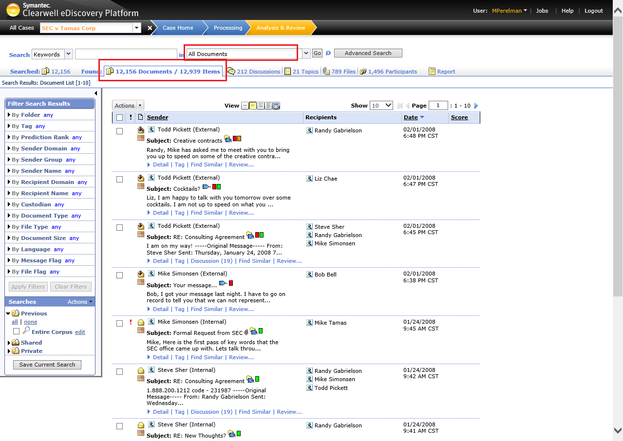
Statistical Sampling With Clearwell
Notes:
The first thing to do with Clearwell is to click the “Go” button next to “All Documents”, to load the entire corpus. Much like Relativity, statistical sampling can be done across the entire corpus, or only certain folders, searches, keyword results, etc.
In our fictional SEC v Tamas Corp case, there are 12,156 documents, and 12,939 reviewable items.

Slide 53
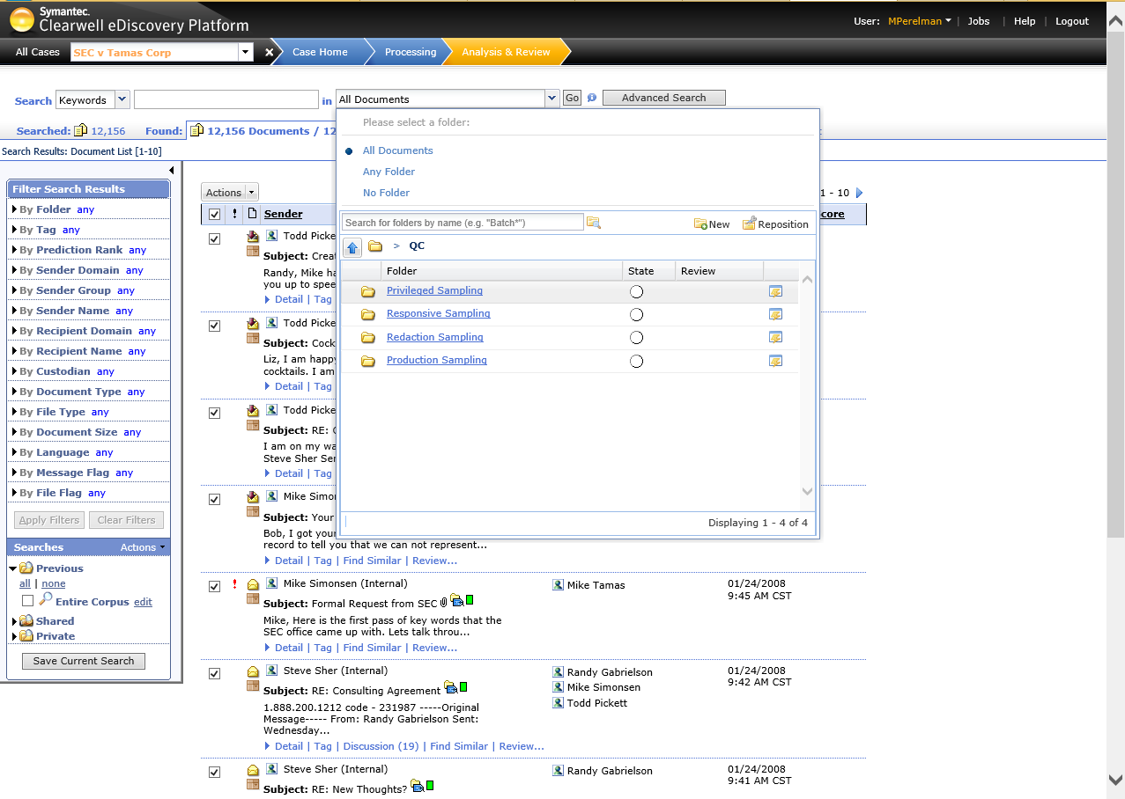
Statistical Sampling With Clearwell
Notes:
Before we sample, we will create a folder to hold our sampled documents. In our case, we’ll call it Privileged Sampling. This can be done by clicking the dropdown next to “All Documents” and selecting “New”

Slide 54
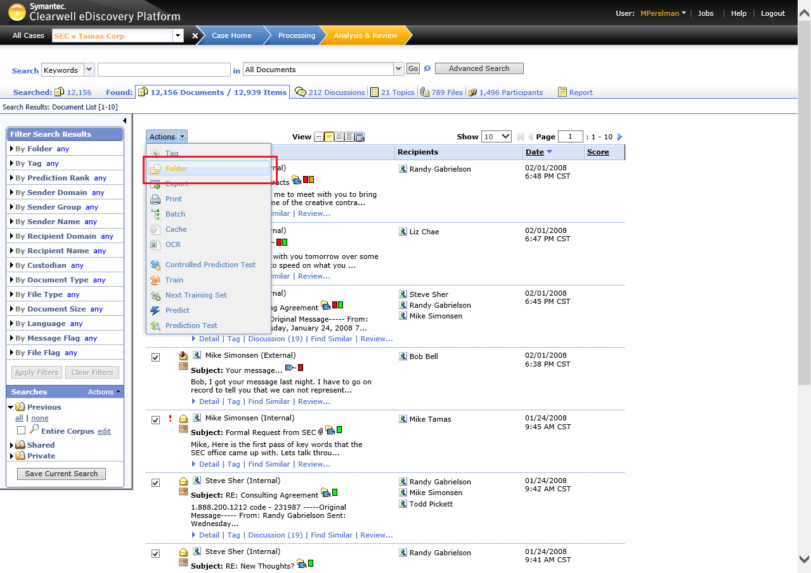
Statistical Sampling With Clearwell
Notes:
Next, we choose the documents by clicking the checkbox under the “Actions” pull-down.
We choose “Actions” and “Folder”. A wizard will appear, which will walk us through copying our results to a folder, including conducting sampling of our results.

Slide 55
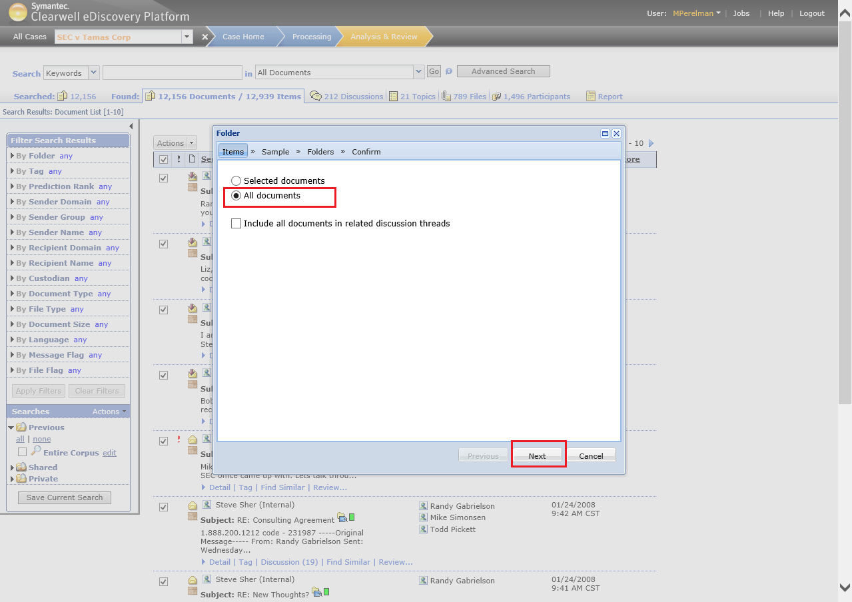
Statistical Sampling With Clearwell
Notes:
The first step is to choose only the checked documents on the page or “All documents” in our search (in our case, the entire corpus). We choose Next.

Slide 56
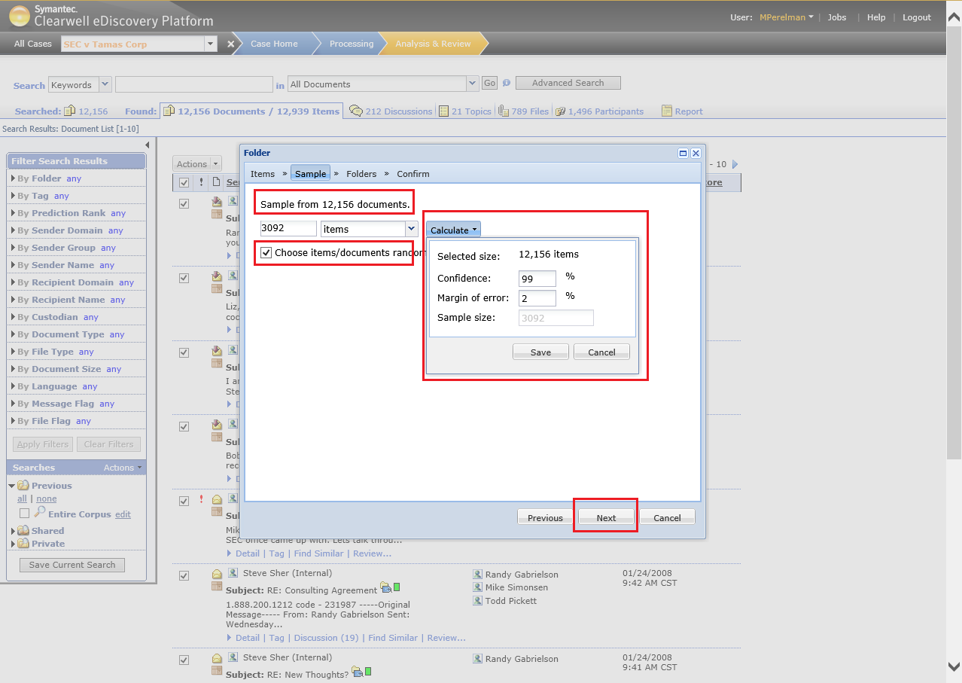
Statistical Sampling With Clearwell
Notes:
Here is where the fun starts. In this dialog, we have an option of selecting a percentage, a specific number of items or clicking “Calculate”, which allows us to enter the Confidence level and Margin of Error values.
It is important to select the “Choose items/documents randomly” option, otherwise your “sample” will be chosen sequentially.
For our population, the total sample is 3,092.

Slide 57
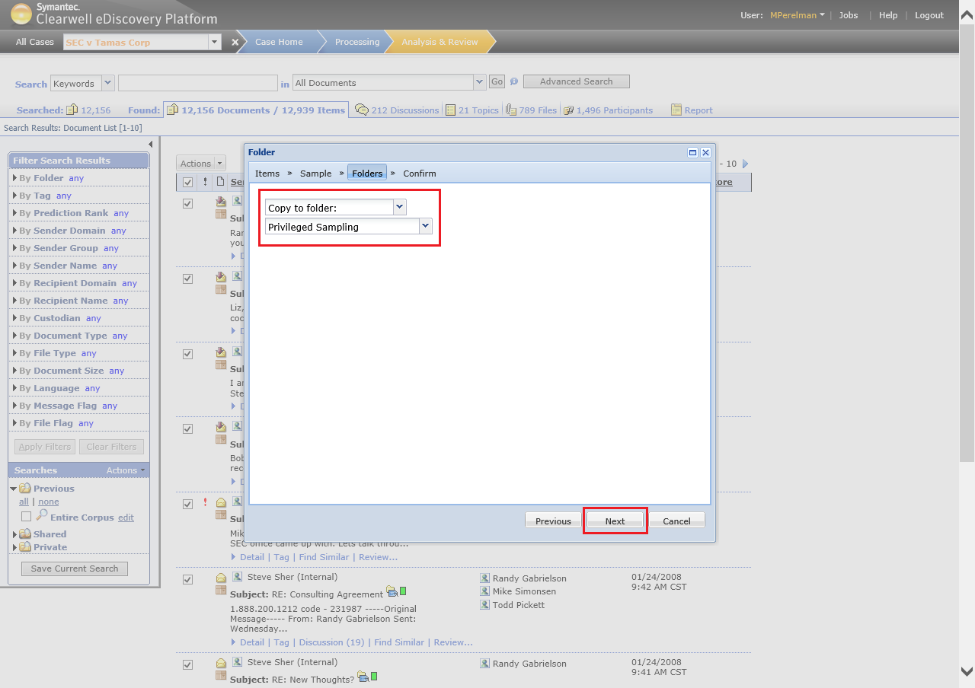
Statistical Sampling With Clearwell
Notes:
In this dialog we will choose “Copy to Folder”, and underneath, choose the folder which will hold our sampled data.

Slide 58
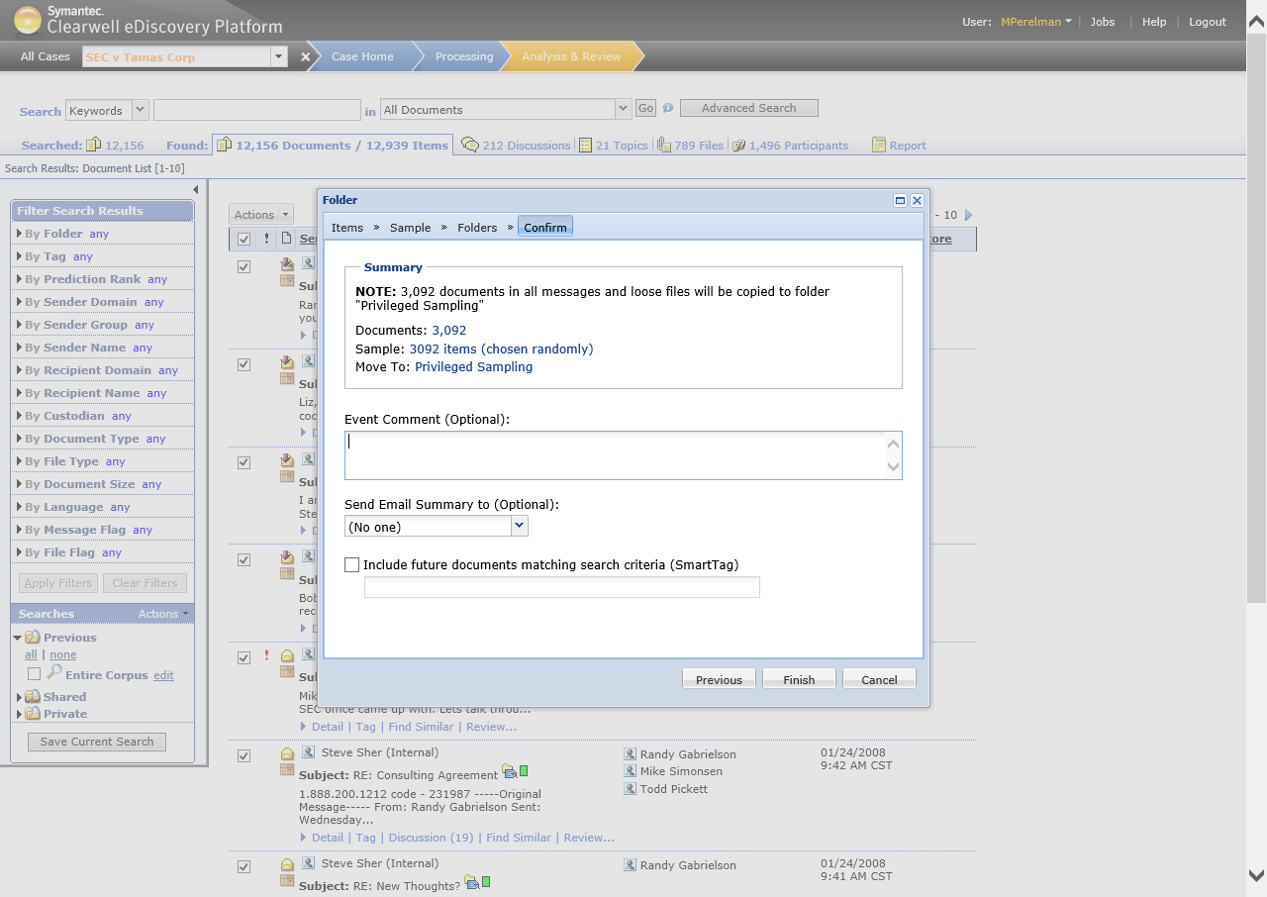
Statistical Sampling With Clearwell
Notes:
A confirmation screen appears, showing that 3,092 items (chosen randomly) will be copied to Privileged Sampling.

Slide 59
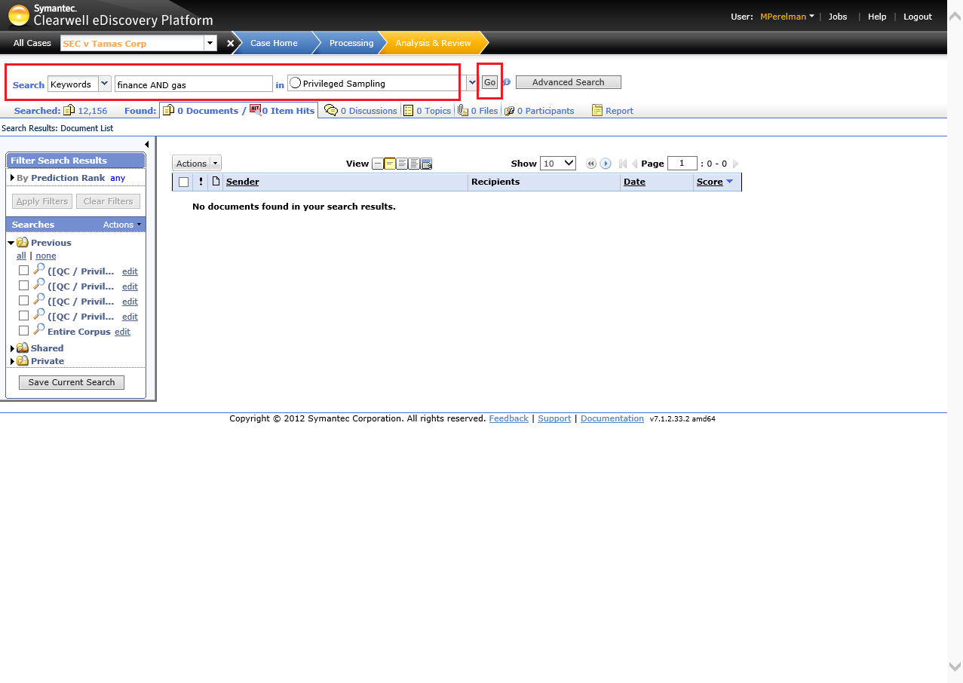
Statistical Sampling With Clearwell
Notes:
Once we have a sample of the total, we can run keyword searches against it to see our results against the sample. Here you can see that we returned 0 results running “finance AND gas” against our privileged sampling set.
An alternative way to do keyword sampling would be to run your keywords against the entire corpus first. Then, statistically sample the results and put those into a folder. Review the sampled results and determine keyword relevance and validity.

Slide 60
Geoff Black
gblack@strozfriedberg.com
Product Manager, Digital Forensics
Stroz Friedberg LLC
https://github.com/geoffblack/EnScript/tree/master/RandomSampleSelector
Albert Barsocchini
abarsocchini@nightowldiscovery.com
Discovery Counsel & Director of Strategic Consulting
NightOwl Discovery

Slide 61
Thank You
Geoff Black and Albert Barsocchini

